Slide 1
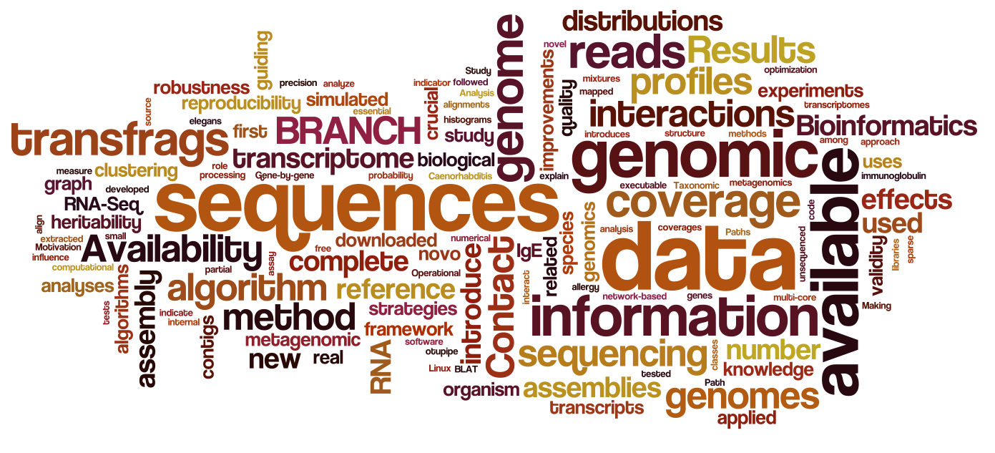
Introduction to Data Science for Biology
Jarrett Byrnes
UMass Boston
Spring 2025

Slide 2
Etherpad! Tell us about YOU!
https://etherpad.wikimedia.org/p/355-spreadsheets-2025_spring
(you can access from the course website – http://biol355.github.io)
(this is also all linked on canvas)

Slide 3
We Are Awash in Data

Slide 4
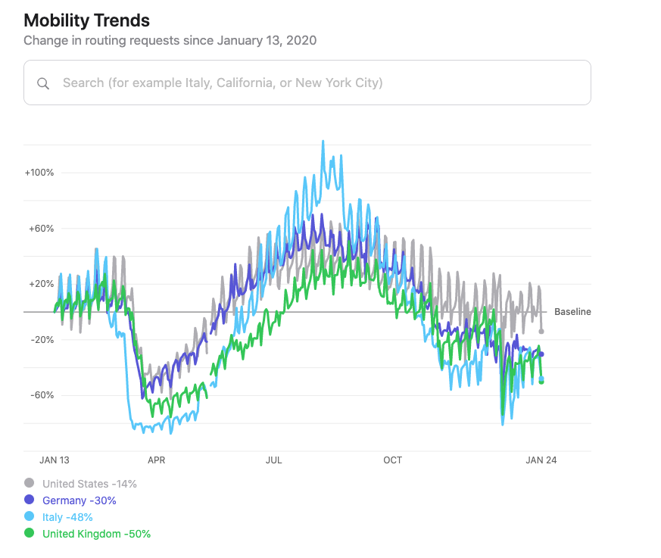

Slide 5
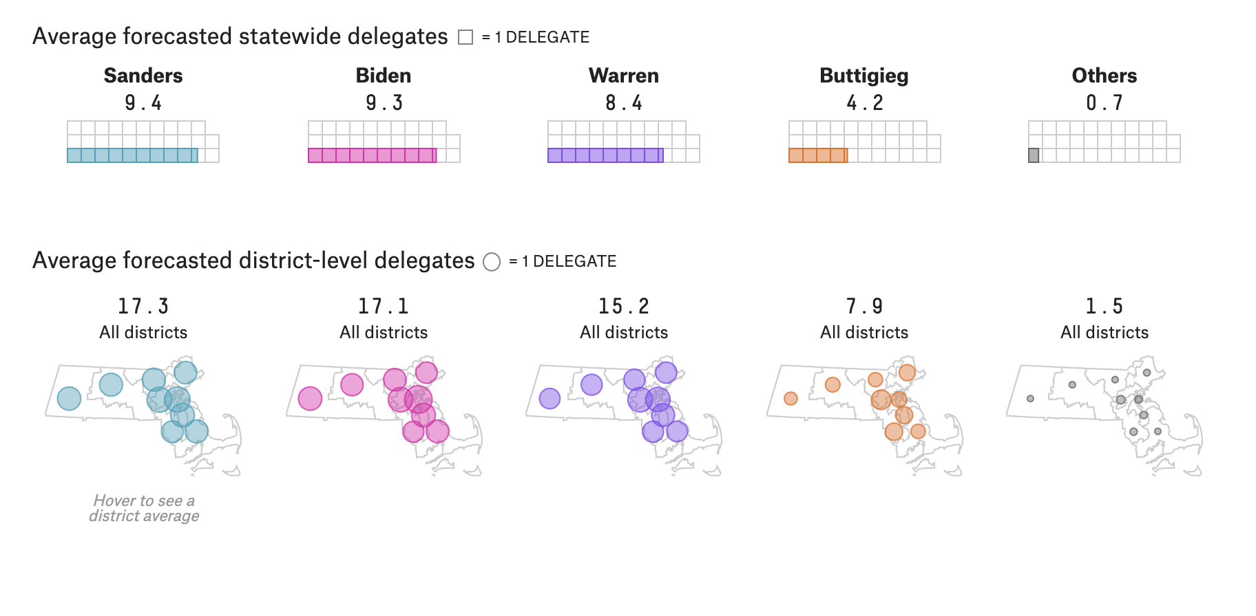
Source: fivethiryeight.com

Slide 6
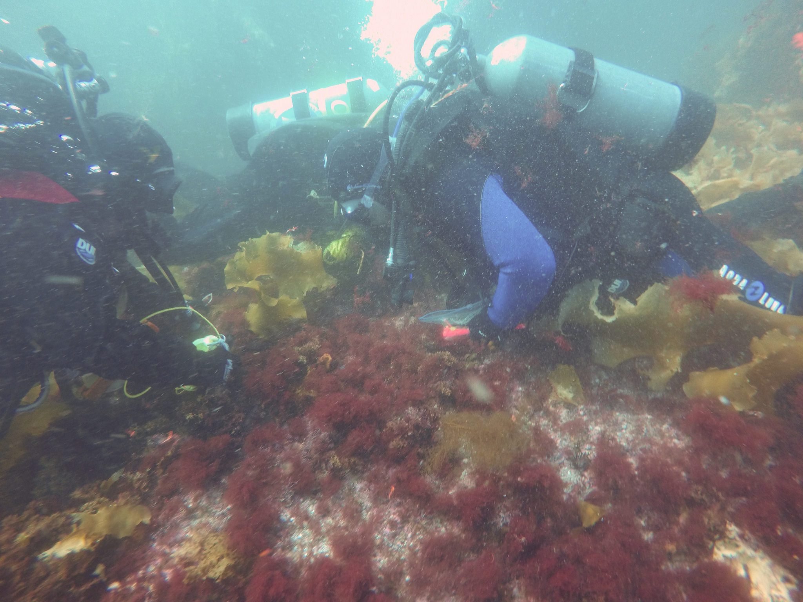

Slide 7
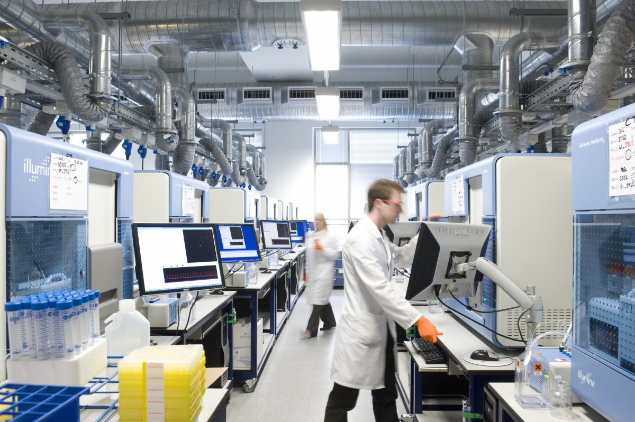

Slide 8
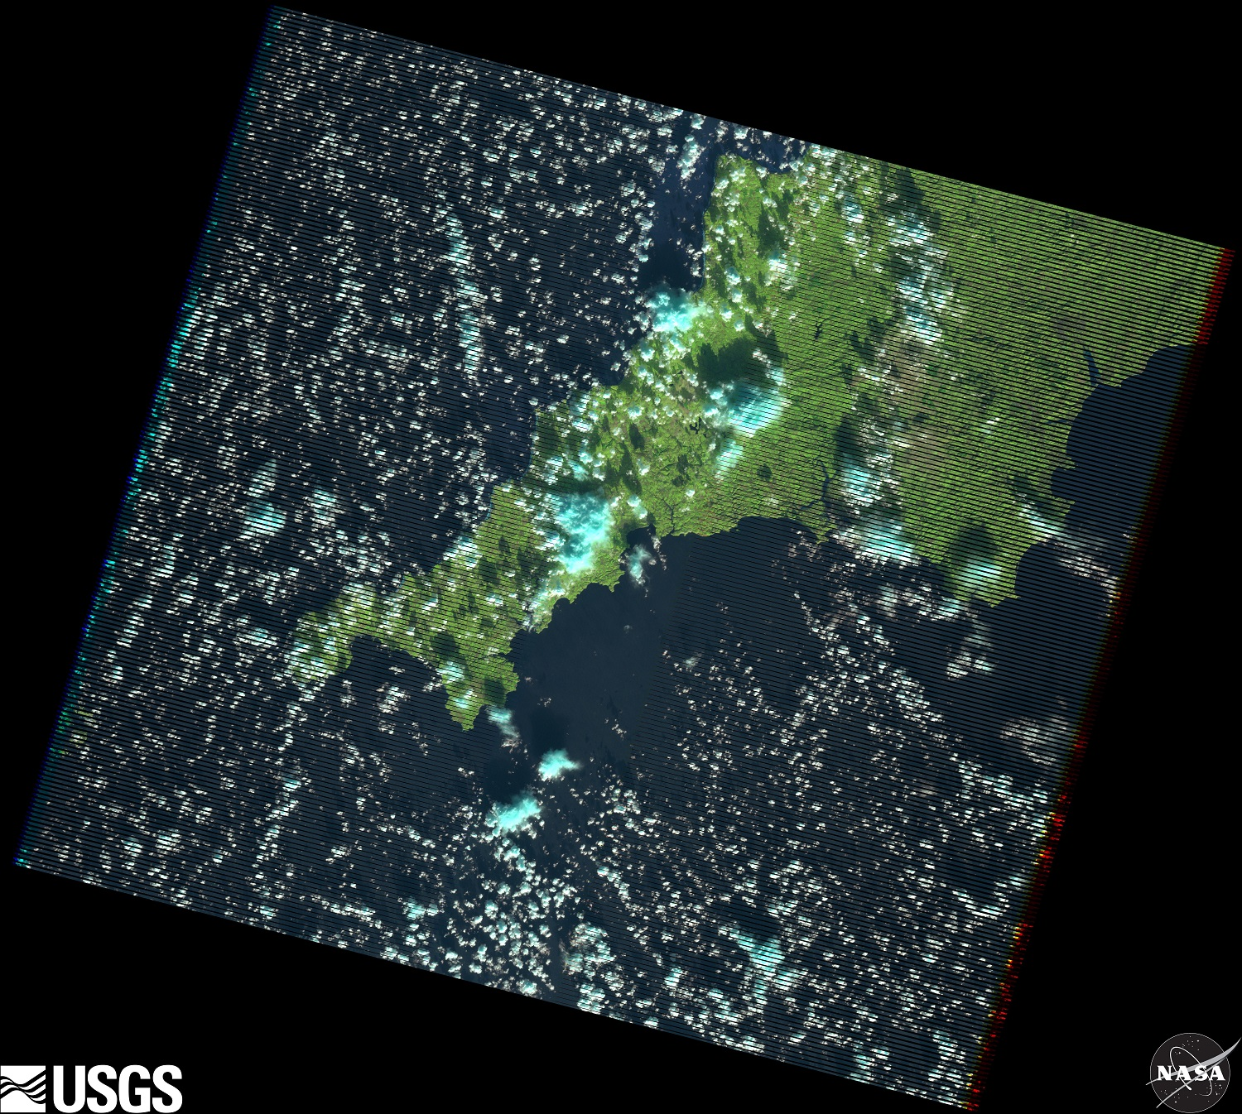

Slide 9
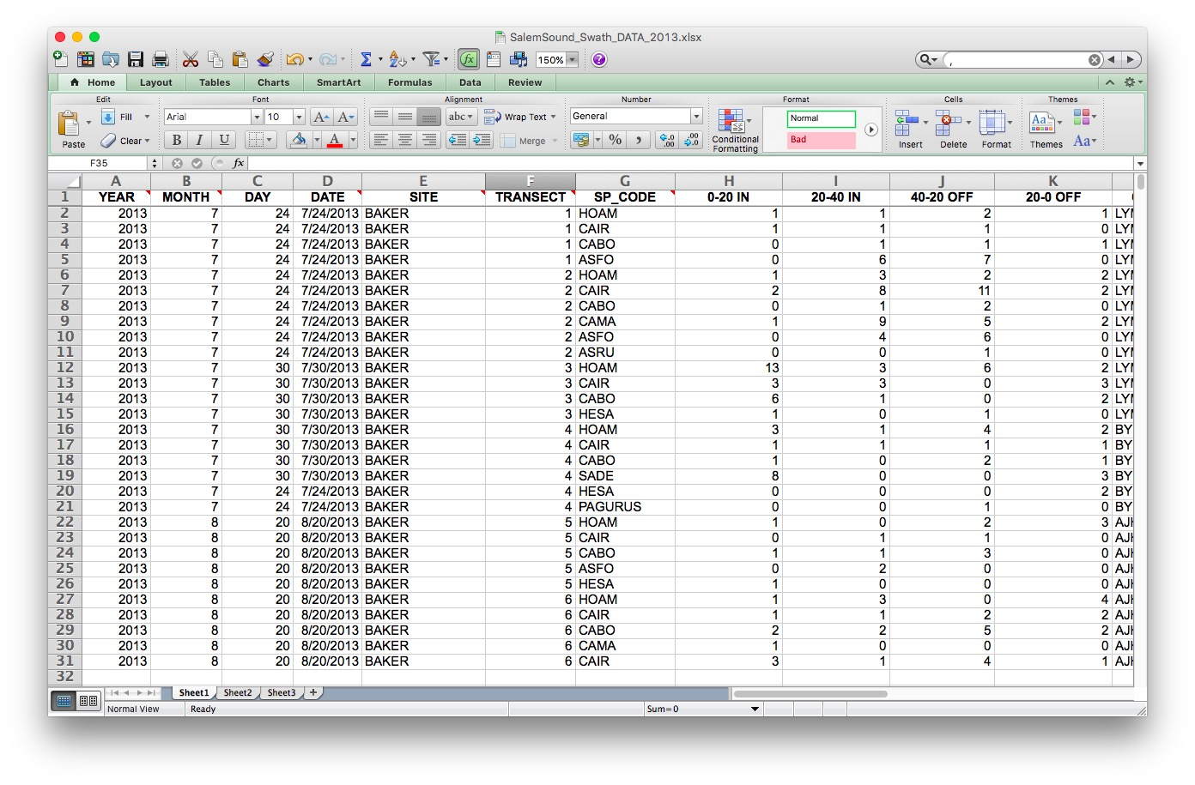

Slide 10
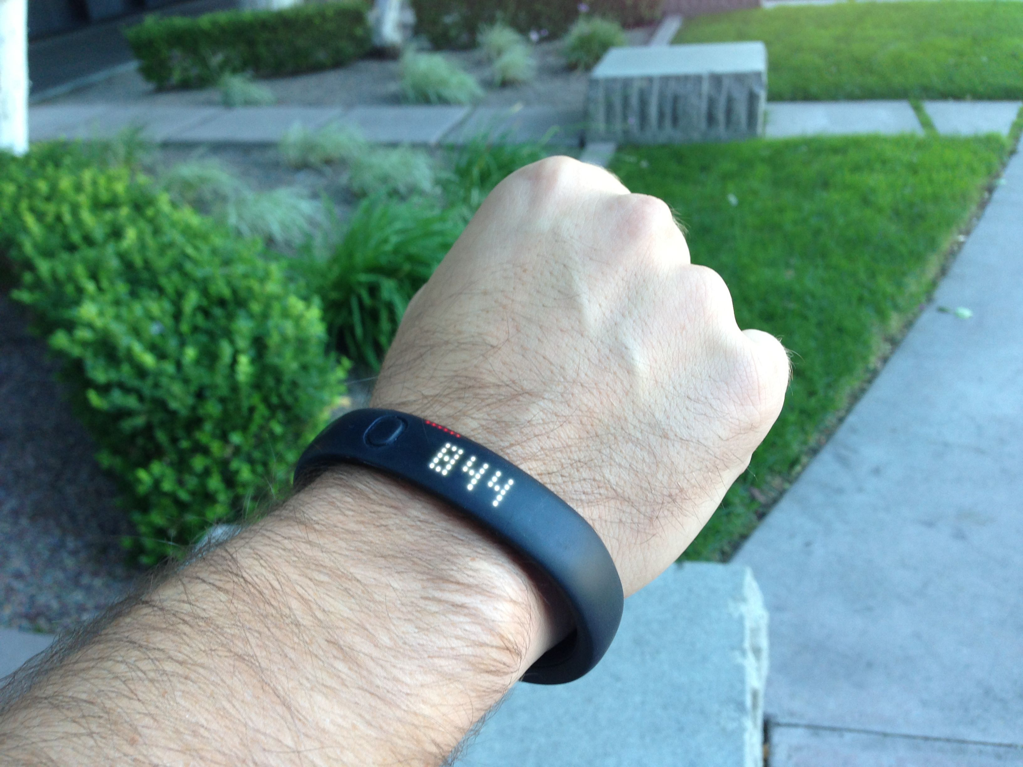
Notes:
The quantified self

Slide 11
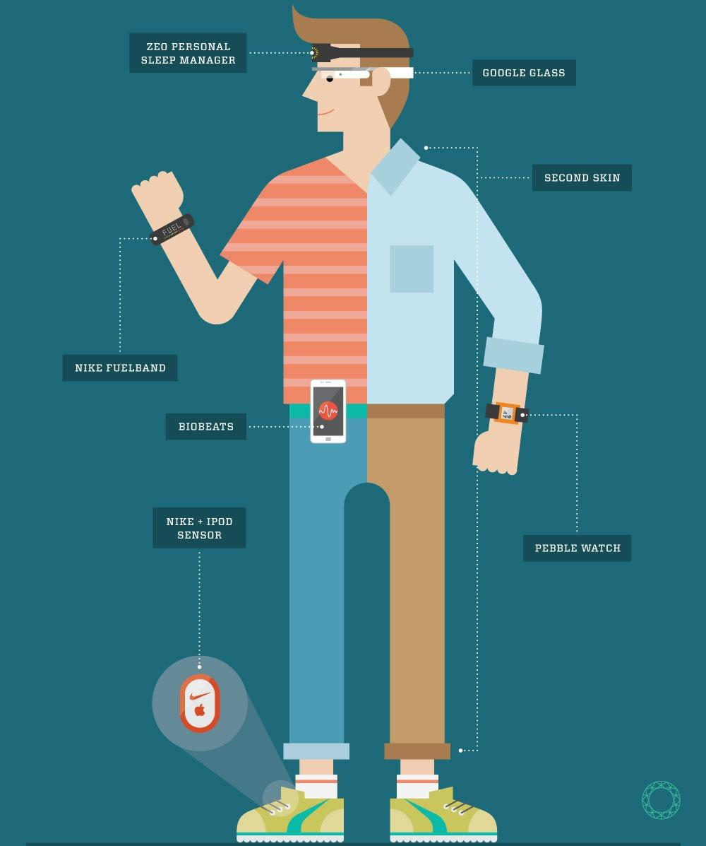

Slide 12


Slide 13
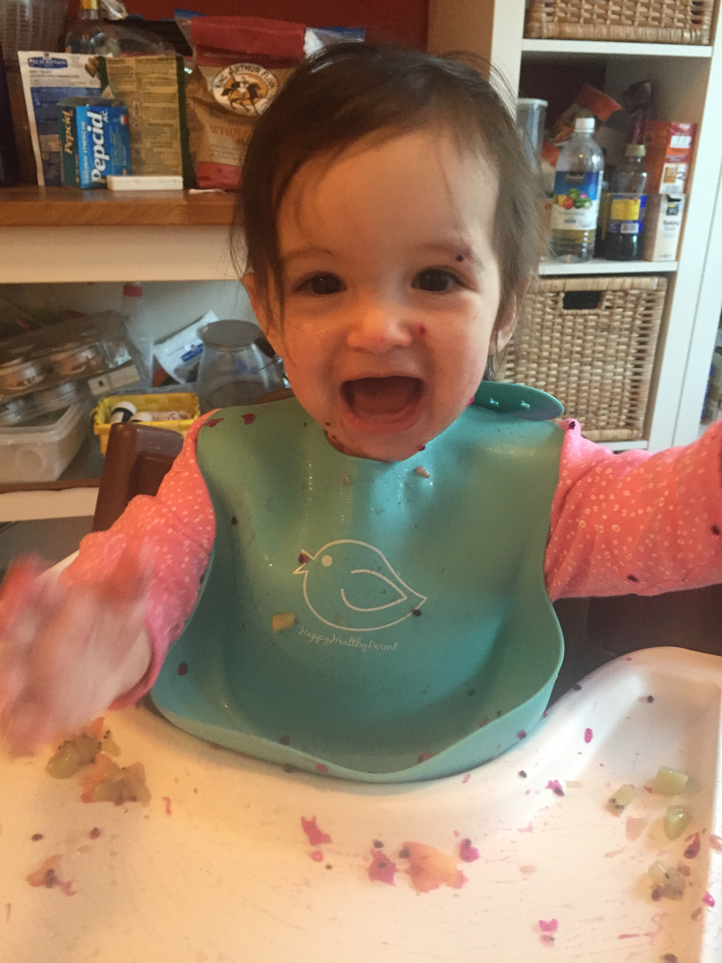

Slide 14
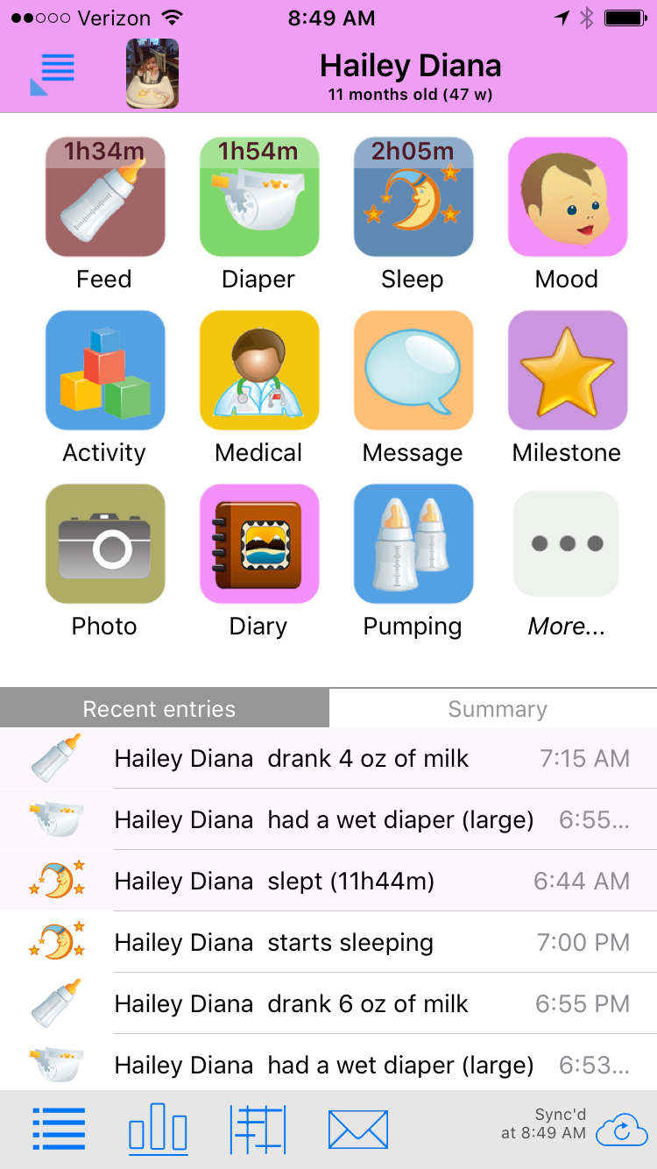

Slide 15
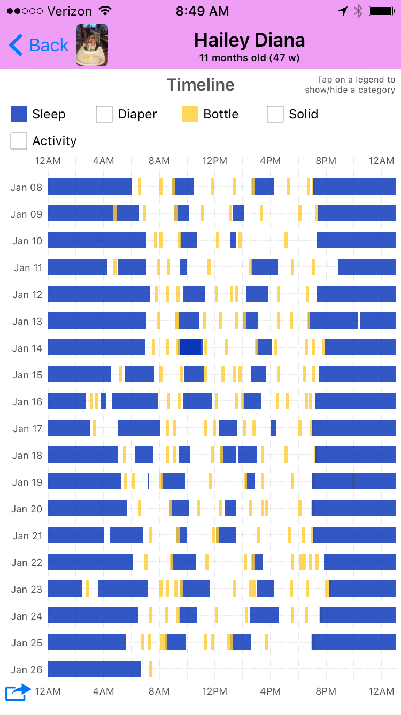

Slide 16
What do you want to learn from data?
Go to https://datasetsearch.research.google.com/
Find something cool
Write a few sentences about it on the etherpad – come back tomorrow and read everyone’s!

Slide 17
Data is at the Center of Biology

Slide 18
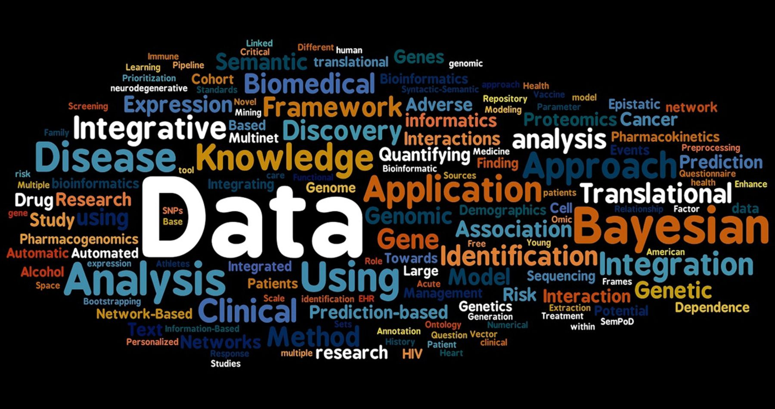

Slide 19
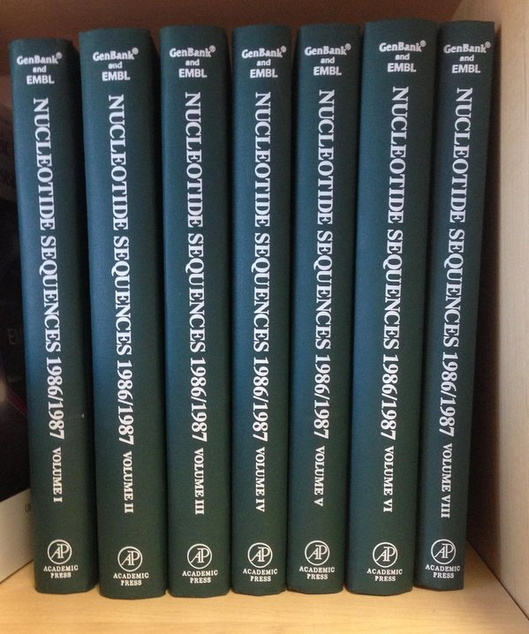
Classical Tools Not Up to the Task

Slide 20
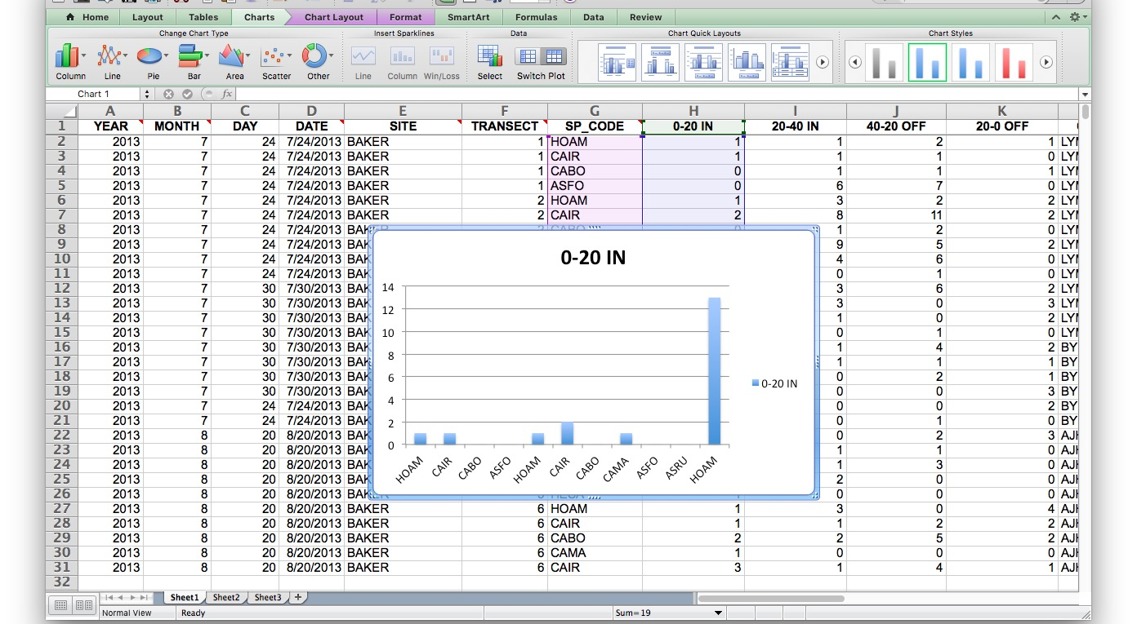
Classical Tools Not Up to the Task
Notes:
Rag on excel here. teehee

Slide 21
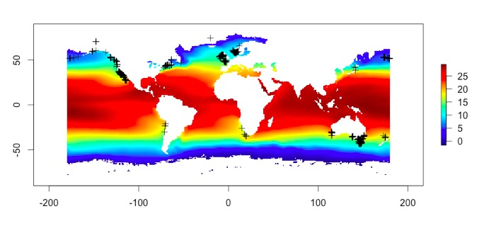
How can we work with mixes of different data sets to derive new inference?

Slide 22
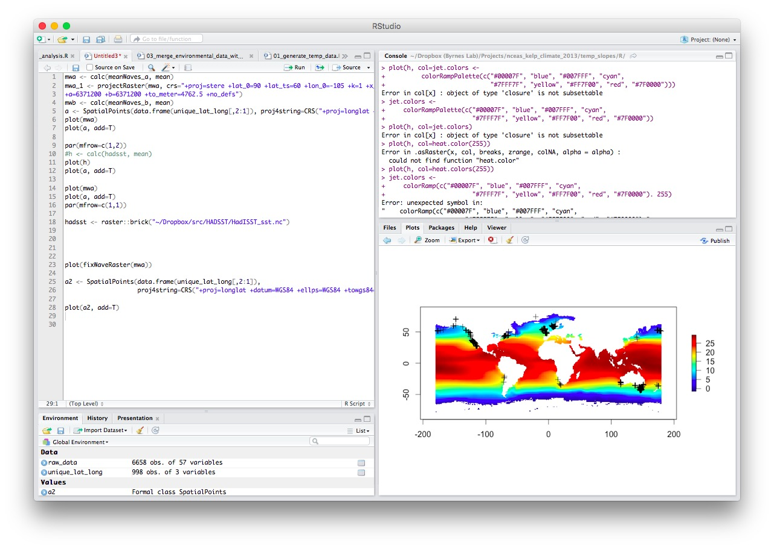

Slide 23
So, programming…
Write a few sentences about your experience with programming or, if you haven’t before, how programming makes you feel.
Share on the Etherpad!

Slide 24
What is Data Science?

Slide 25
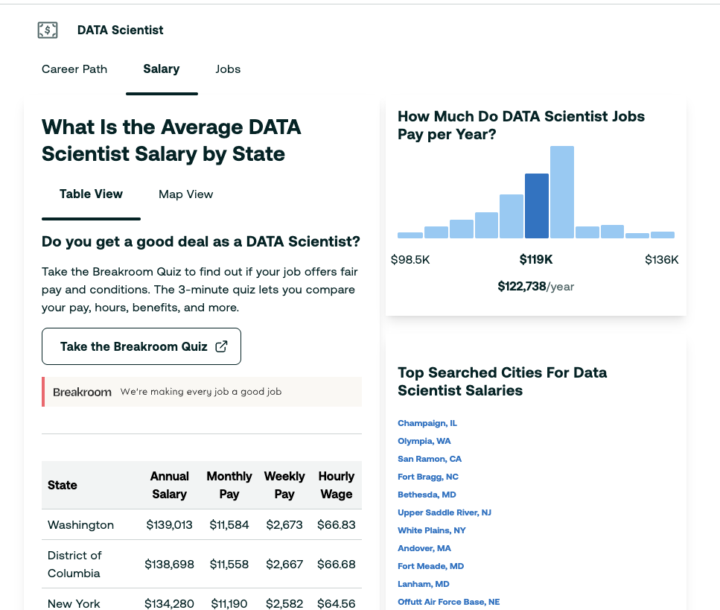

Slide 26
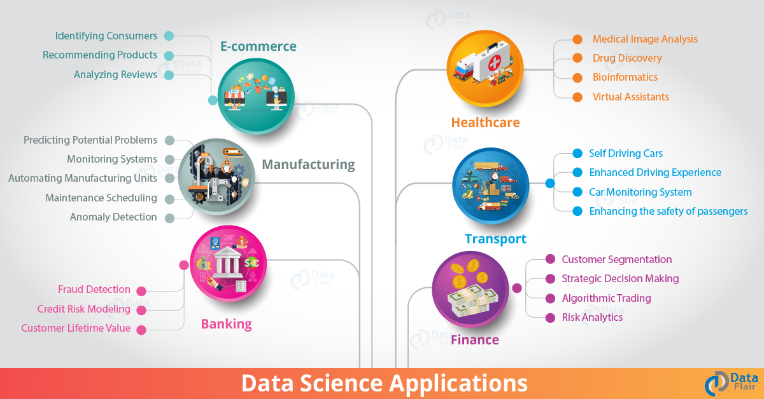

Slide 27
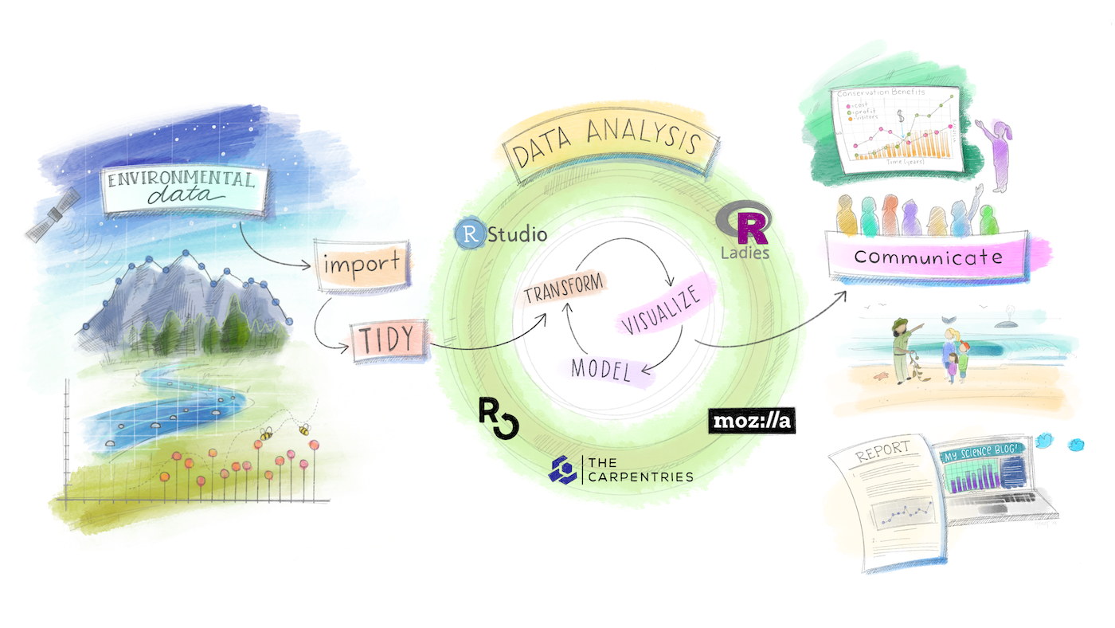
The Data Science Fandango
© Allison Horst

Slide 28
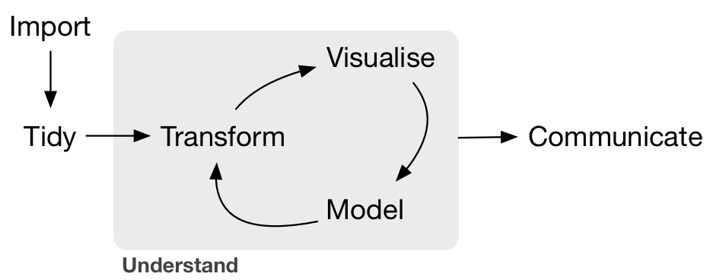
This Class
Week 1-3
Week 4, 8-9
Week 2, 8-9, 11
Week 5-7,10
Week 12-14

Slide 29
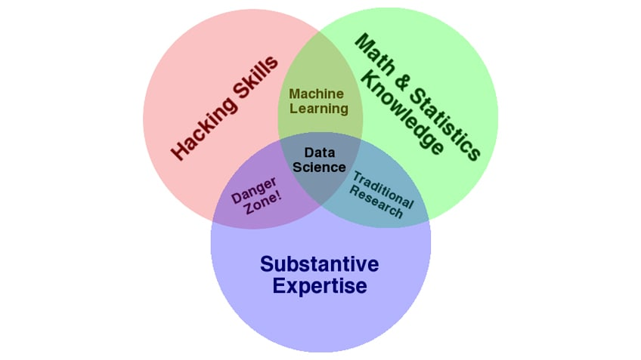
Why is this course “in Biology”?

Slide 30
Introduction to Data Science for Biology

Slide 31
Our Semester

Slide 32
Learn how to create efficient understandable datasets for biological research
YEAR | MONTH | DAY | DATE | SITE | TRANSECT | SP_CODE | 0-20 IN | 20-40 IN | 40-20 OFF | 20-0 OFF | OBSERVER
2013 | 7 | 24 | 7/24/2013 | BAKER | 1 | HOAM | 1 | 1 | 2 | 1 | LYMAN
2013 | 7 | 24 | 7/24/2013 | BAKER | 1 | CAIR | 1 | 1 | 1 | 0 | LYMAN
2013 | 7 | 24 | 7/24/2013 | BAKER | 1 | CABO | 0 | 1 | 1 | 1 | LYMAN
2013 | 7 | 24 | 7/24/2013 | BAKER | 1 | ASFO | 0 | 6 | 7 | 0 | LYMAN
2013 | 7 | 24 | 7/24/2013 | BAKER | 2 | HOAM | 1 | 3 | 2 | 2 | LYMAN
2013 | 7 | 24 | 7/24/2013 | BAKER | 2 | CAIR | 2 | 8 | 11 | 2 | LYMAN
2013 | 7 | 24 | 7/24/2013 | BAKER | 2 | CABO | 0 | 1 | 2 | 0 | LYMAN
2013 | 7 | 24 | 7/24/2013 | BAKER | 2 | CAMA | 1 | 9 | 5 | 2 | LYMAN
2013 | 7 | 24 | 7/24/2013 | BAKER | 2 | ASFO | 0 | 4 | 6 | 0 | LYMAN
2013 | 7 | 24 | 7/24/2013 | BAKER | 2 | ASRU | 0 | 0 | 1 | 0 | LYMAN

Slide 33

Learn common programming language(s) associated with data science

Slide 34

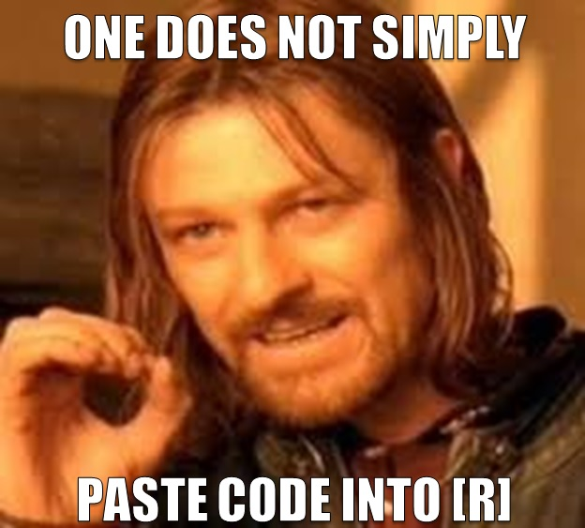

Slide 35
Course AI Policy
1
Don’t
2
AI/Vibe coding can be useful IF AND ONLY IF you know a language in the first place
3
If you will use AI, go take a different class please

Slide 36
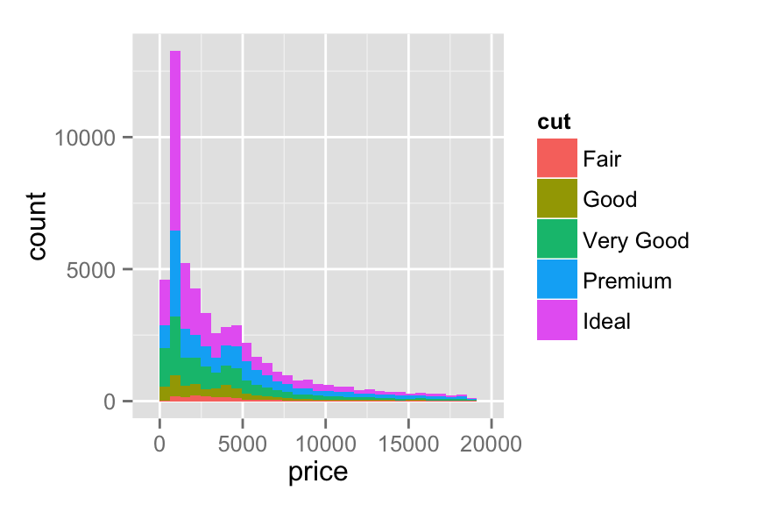
Build a vocabulary of visualization tools that enable students to see what their data means

Slide 37
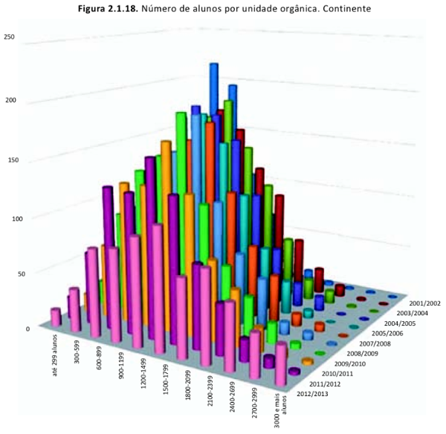
This is How I Know I Failed You

Slide 38
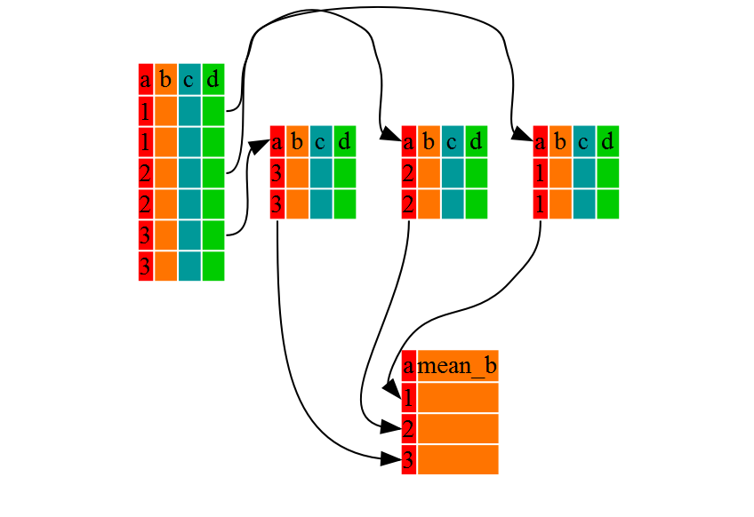
Develop an understanding of how to manipulate data for the purposes of seeing useful patterns
http://swcarpentry.github.io/r-novice-gapminder/

Slide 39


Slide 40
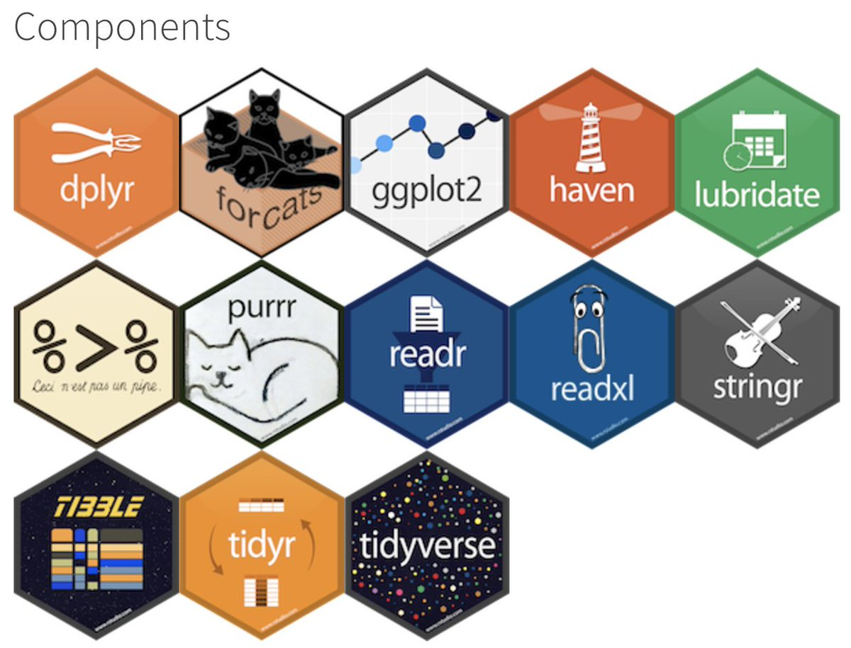

Slide 41
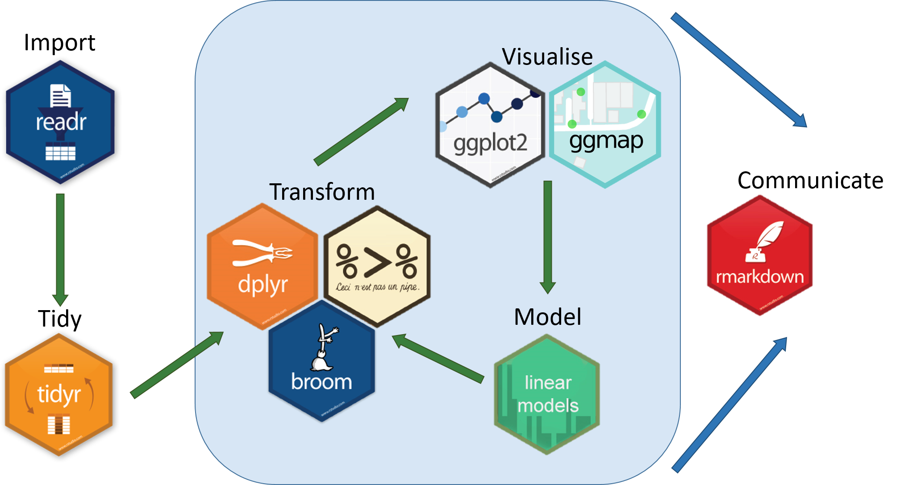

Slide 42
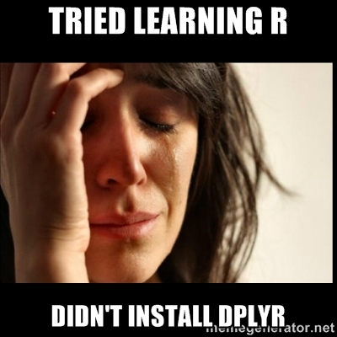
Notes:
The tidyverse!

Slide 43
Understand how to unify data from disparate sources to build a larger picture of biological phenomena

Slide 44

Learn basic analytical tools for deriving statistical inference from data

Slide 45
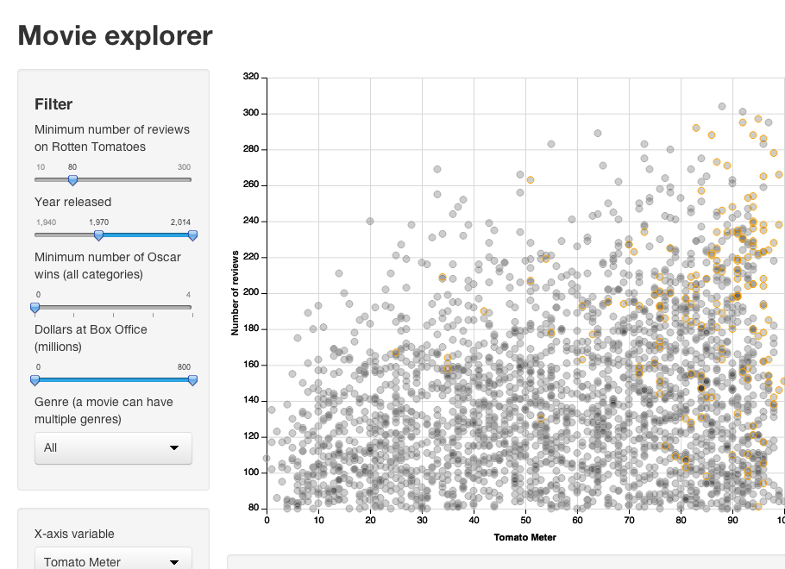
Determine Strategies for Communicating Results of Data Explorations for Use by Others

Slide 46
This Class

Slide 47
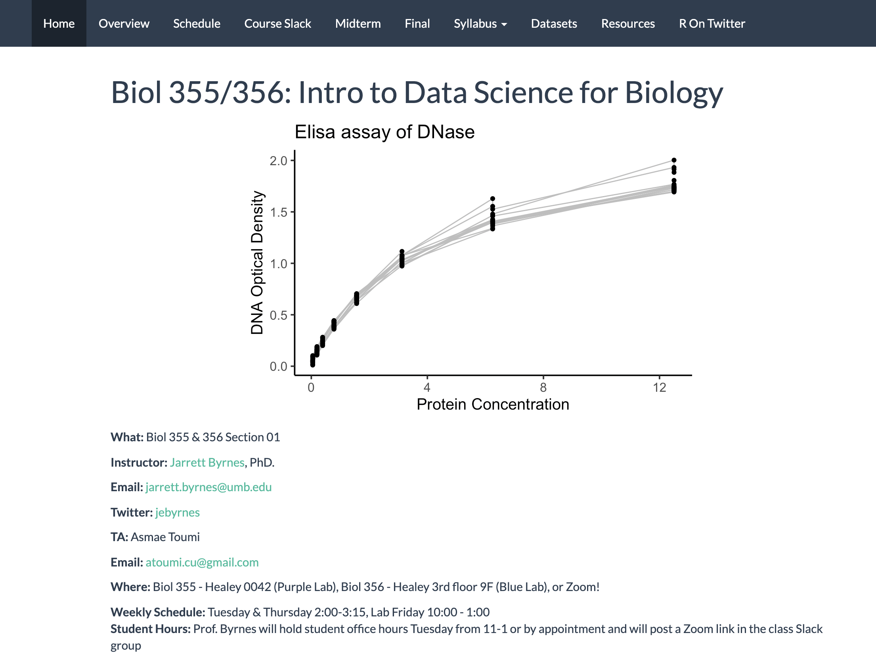
Course Web Page
http://biol355.github.io

Slide 48

“Text”book & Weekly Readings
http://r4ds.had.co.nz/

Slide 49
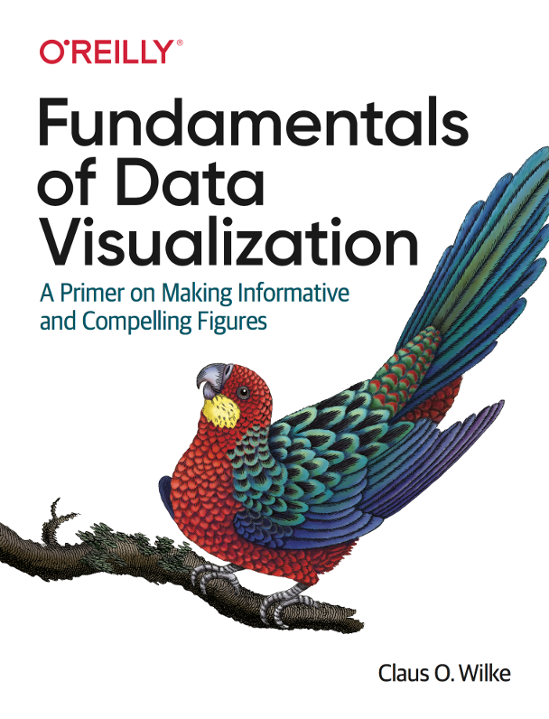
Additional Resources
https://clauswilke.com/dataviz/

Slide 50

http://www.datacarpentry.org/

Slide 51
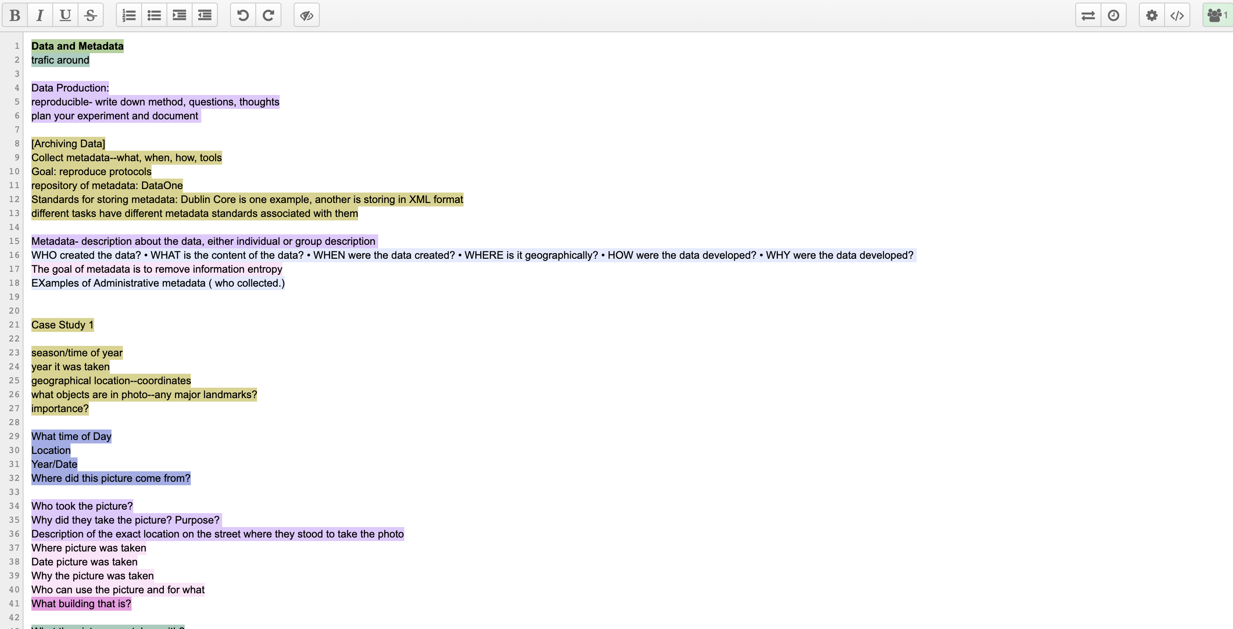
Etherpad: How we will Communicate During Class

Slide 52
Lab
Coding!
TA: Daniel Lopez
Guided examples and then challenge problems

Slide 53
Assignments
Weekly problem sets
Variable in scope!
May involve elements of your final project
Can be started in lab
Will highlight concepts from that week

Slide 54
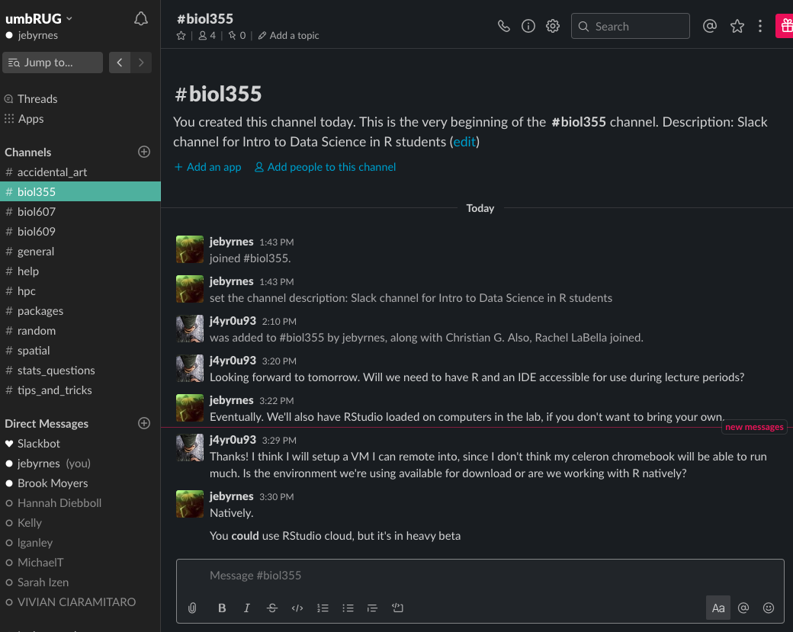
Slack for out of class interactions
Weird R errors?
Questions?
Something nerdy and funny?

Slide 55
JOIN SLACK NOW!
Go to the link in today’s etherpad
Join the channel #biol355
Post a hello and one thing you hope to get from this semester

Slide 56
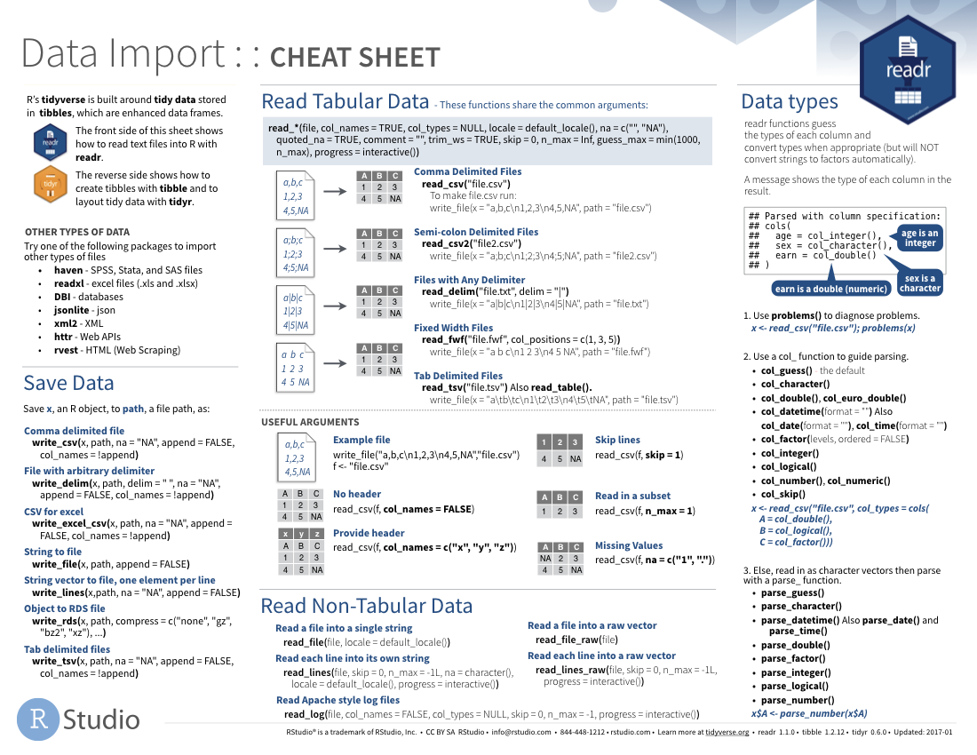
R Cheat Sheet Midterm
See https://rstudio.com/resources/cheatsheets/ and https://rstudio.com/resources/cheatsheets/how-to-contribute-a-cheatsheet/

Slide 57
Final Project
Interactive presentation of data
Can be from your own work
See examples at https://biol355.github.io/projects_2020.html
Data mashups encouraged!
Bring together multiple public sources of data
We will be asking questions about your dataset in the homework
What data will you be using?
What question do you want to answer?

Slide 58
Next Time: Data Collection, Entry, and How to Make Your Data Usable (and have future you avoid wanting to kill now you)
(Read the Browman and Woo paper!)

